Slide 1









FleetIQ
Team: Sanika Dhanwate and Gandhali Sheth

Slide 2





About
Our Project
Predictive Maintenance for Electric Vehicle Fleets
Project Purpose
To build a predictive maintenance system that replaces fixed-interval EV servicing with accurate, data-driven forecasts to reduce failures, downtime and cost.
Expected Outcomes
A model that predicts Remaining Useful Life (RUL) and identifies failing components (CHS), enabling planned, cost-efficient maintenance.
Operating Philosophy
Maintain EVs based on real health signals, not schedules — act before failure using continuous telematics and ML insights.
FleetIQ
02

Slide 3









Project Motivation
Why it matters?
Why Predictive Maintainace
Team Motivation
EV fleets need reliability
Sensor + ML predicts failures early.
Passion for real-world IoT + data science + EV health.
Current maintenance is inefficient
Improves safety, reduces downtime and extends vehicle lifespan.
Excited to build a scalable predictive maintenance solution (FleetIQ).
FleetIQ
03

Slide 4



Data Overview
Why this matters
High-resolution signals capture real degradation patterns
Required for accurate RUL & CHS predictions
Enables both forecasting (“when”) and diagnostics (“why”)
Data Profile
175,393 observations • 31 features
15-minute telemetry readings over 5 years (2020–2025)
Fully clean dataset with zero missing values
Data Source
Innovation
EVIoT-PredictiveMaint dataset from IoT-enabled EV fleets
Multi-sensor data: battery temp, SoH, vibration, brake wear, voltage, cycles
Uses real EV telematics for condition-based maintenance, not assumptions
Combines physics-driven signals + machine learning
Enables actionable insights: early failure detection & component-level diagnosis
FleetIQ
04

Slide 5





Model Conjectures
Conjecture 1: Stress Predicts RUL
Conjecture 2:
Degradation is Non-Linear
Conjecture 3:
CHS Driven by Key Sensors
Battery Temperature, Motor Vibration, Charge Cycles drive degradation
Better than mileage/speed
Foundation for RUL model
Interactions matter (temp × current)
Random Forest is appropriate
Supports model accuracy
Identifies where degradation occurs
Enables diagnostics
Drives FleeIQ’s actionable insights
FleetIQ
05

Slide 6





The Model
Two Predictive Models
The “When”
The“Why/Where”
RUL Model
CHS Model
Why Random Forest Works Well
Predicts Remaining Useful Life (days before maintenance is needed).
Enables early scheduling and reduces unplanned downtime.
Predicts Component Health Score (0–1).
Identifies which components are degrading (battery, motor, brakes).
Captures complex interactions between sensor variables.
Resistant to noise and overfitting.
Provides interpretable outputs (top predictors driving degradation).
FleetIQ
07

Slide 7

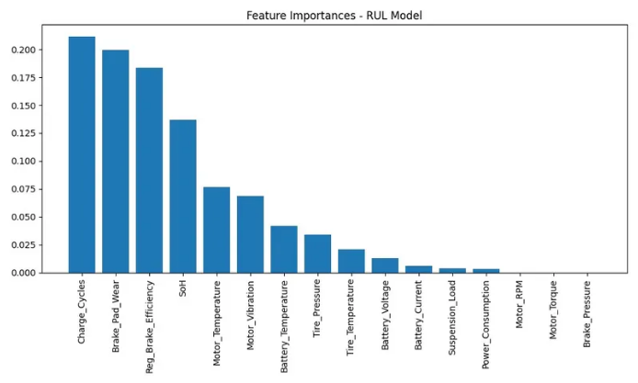

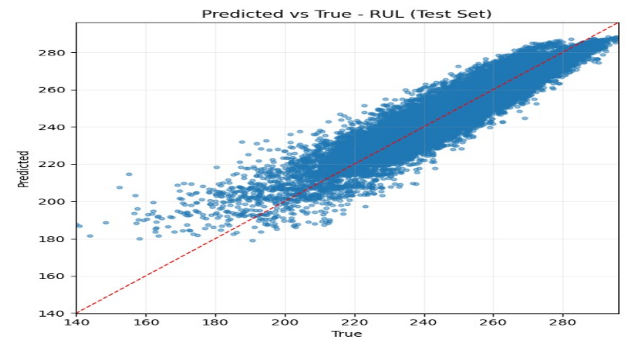
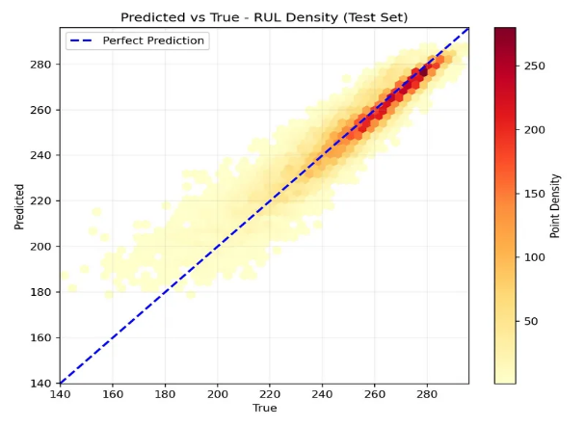
RUL RESULTS
Interpreation:
Reliable for scheduling maintenance in advance → reduces unexpected failures and fleet downtime.
Explained Variance
R² Score
MAE
Median AE
MSE
55.1
5.61
days
4.38
days
0.8888
0.8889
FleetIQ
06

Slide 8


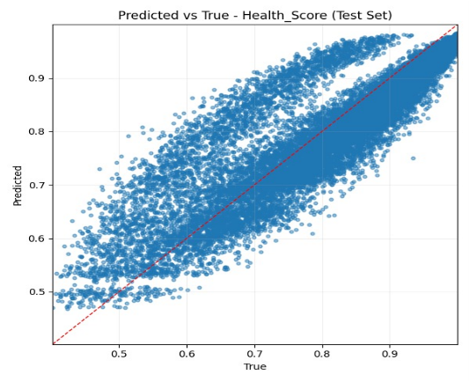
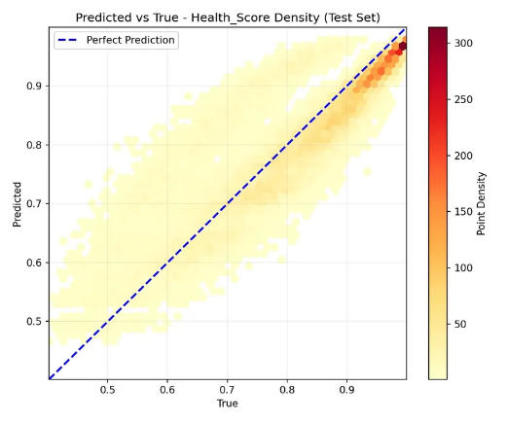
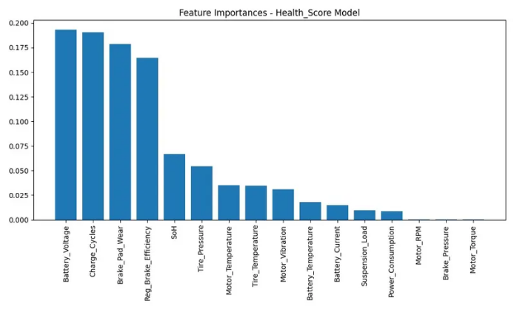

CHS RESULTS
What we predicted
Component Health Score (0–1): indicates current health of battery, motor and brake systems.
Top Features Driving CHS:
Brake_Pad_Wear – brake degradation
Battery_Voltage – electrical state
Charge_Cycles – battery usage
Regen_Braking_Efficiency – energy recovery
SoH (State of Health) – overall battery health
Explained Variance
R² Score
MAE
Median AE
MSE
0.0047
0.0512
days
0.0366days
0.7643
0.7643

Slide 9





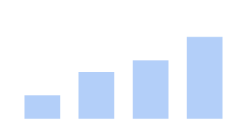

Business Value
Reduce Unplanned Downtime
Operational Efficiency
Cost Optimization
↓ 30% Unplanned Downtime
↓ 20% Maintenance Costs
↑ Extended Asset Life
RUL predictions enable preventive scheduling weeks in advance
Proactive maintenance reduces emergency repairs and improves fleet scheduling.
CHS diagnostics help target the exact component failing, reducing unnecessary part replacements.
70%
80%
60%
70% of failures can be anticipated with RUL
80% of scheduling decisions become proactive instead of reactive
meaning: 60% of maintenance spending becomes planned
rather than reactive
FleetIQ
08

Slide 10










Project Story
Data
EV telematics shows real degradation behavior
Derick collected data • Sanika validated & explored
Analysis
Conjectures reveal stress drives wear
Sanika drove EDA • Aidan & Derick provided domain insights
Models
RUL (“when”) + CHS (“why/where”)
Gandhali built & optimized models • Aidan engineered features
Results
Accurate predictions + component insights
Gandhali delivered metrics • Sanika created result visuals
Impact
Less downtime, lower cost, smarter maintenance
Entire team aligned results to business value
FleetIQ

Slide 11


FleeIQ:
The Future of Fleet Maintenance
Thank you
Questions?

